Slide 1
CSE332 INDUSTRY ETHICS AND LEGAL ISSUES

Slide 2
- Creating an ethical work environment - Ethical decision making

Slide 3
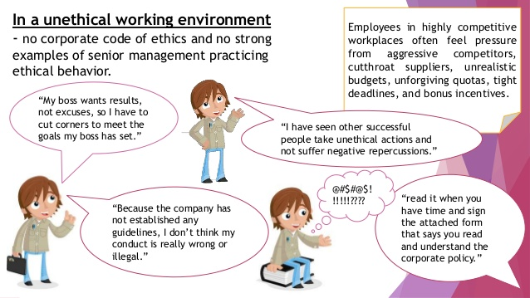
Creating an Ethical Work Environment

Slide 4
A company implements an employee monitoring system that tracks emails, internet usage, and office location without informing employees.
Analyze the ethical implications of this practice.
Suggest measures to balance employee privacy and organizational security.
Notes:
Employee monitoring can improve security but may violate privacy if not communicated. Organizations should have clear privacy policies, obtain employee consent, and restrict monitoring to work-related activities only.
Example: Google's privacy policy explicitly informs employees of the type of data being monitored.

Slide 5
Question: A software company releases a mobile app without adequate security testing. A data breach exposes user information.
Evaluate the ethical responsibility of the company.
What steps should the company take to regain customer trust?
Notes:
Explanation: Ethical responsibility includes ensuring user data protection through rigorous testing. The company must notify users, provide compensation, and implement security patches.
Example: Facebook's response to the Cambridge Analytica scandal involved revising its privacy policies.

Slide 6
Copyright Violation and Software Piracy
Question: A small software development company uses pirated versions of licensed design software to cut costs.
Analyze the ethical and legal implications of this action.
How can the Business Software Alliance (BSA) play a role in such situations?
Notes:
Using pirated software violates copyright laws and damages the software industry. The BSA investigates software piracy cases and encourages the use of licensed software through legal action and awareness campaigns.
Example: Adobe's anti-piracy program encourages companies to use genuine software and reports piracy to BSA.

Slide 7
Creating an Ethical Work Environment
Employees must have a knowledgeable resource with whom they can discuss perceived unethical practices

Slide 8
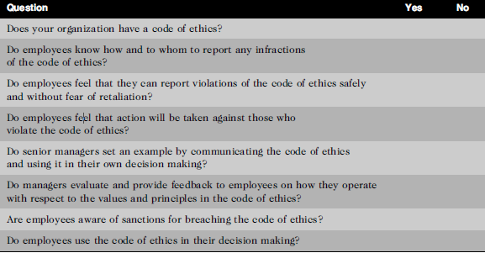
Creating an Ethical Work Environment
Manager’s checklist for establishing an ethical work environment

Slide 9

DECISION

Slide 10

DECISION MAKING

Slide 11
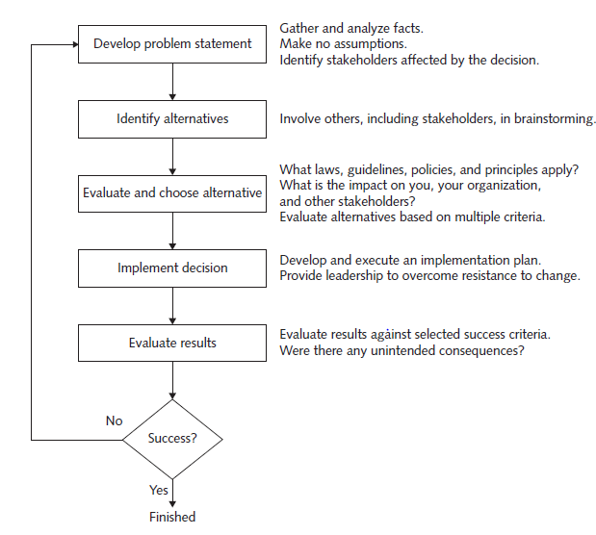
INCLUDING ETHICAL CONSIDERATIONS IN DECISION MAKING

Slide 12


Slide 13
DEVELOP A PROBLEM STATEMENT
A problem statement is a clear, concise description of the issue that needs to be addressed.
It Answers-
What do people observe that causes them to think there is a problem?
Who is directly affected by the problem?
Is anyone else affected?
How often does the problem occur?
What is the impact of the problem?
How serious is the problem?

Slide 14


Poor problem statement
Good problem statement

Slide 15
IDENTIFY ALTERNATIVES
It is ideal to enlist the help of others, including stakeholders, to identify several alternative solutions to the problem.
Brainstorming with others will increase your chances of identifying a broad range of alternatives and determining the best solution.
Try not to be critical of ideas, as any negative criticism will tend to shut down the discussion, and the flow of ideas will dry up.
Simply write down the ideas as they are suggested.

Slide 16
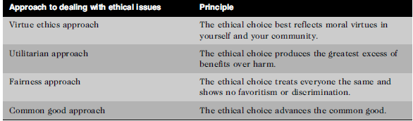
EVALUATE AND CHOOSE AN ALTERNATIVE

Slide 17
IMPLEMENT THE DECISION
Once an alternative is selected, it should be implemented in an efficient, effective, and timely manner.
Why are we doing this?
What is wrong with the current way we do things?
What are the benefits of the new way for you?

Slide 18
EVALUATE THE RESULTS
Were the success criteria fully met?
Were there any unintended consequences?

Slide 19
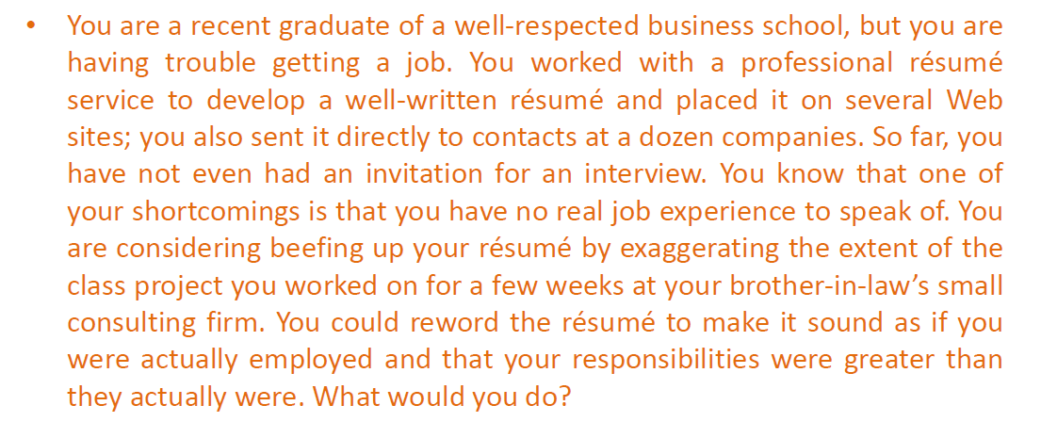

Slide 20
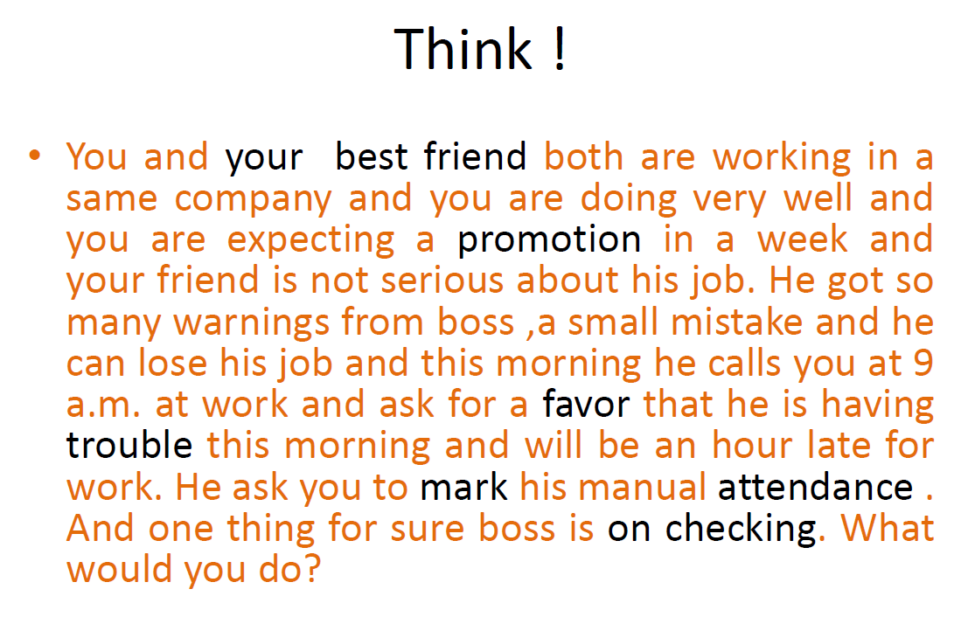

Slide 21
Next Topics:
Ethics in Information Technology
Ethical behavior of IT professional
Common ethical issues for IT users
Supporting the ethical practices of IT users

